Slide 1
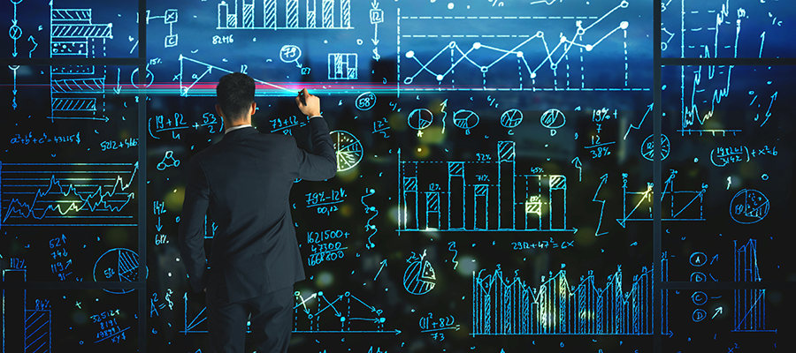

Analytics, Technology, Digital

Slide 2
Executive Summary
Completions project at Devon
Objective
Build a mobile or desktop application that can be used on field sites by Devon’s Person in Charge (PIC) to improve operational decisions or behaviors, during hydraulic fracturing.
Special consideration should be given to unique, creative visualizations and the incorporation of gamification of the interface
1
2
Business Impact
Improve PIC on job productivity and enable quicker decision making process
Enable real time collaboration between “well contractors, site engineer, PIC and control station”
Use real time data to provide meaningful business insights
Minimize on job accidents
1
2
3
4

Slide 3
Executive Summary
Project Economics and attributes impacting completion
Completions projects are cost intensive and has a direct impact on Devon’s bottom line and profitability.
Project consists of nearly 30 stages and each stage can cost $200K
Currently project economics are reviewed by corporate teams. Review at stage level is not conducted
PIC and Engineers do not have access to stage level project economics
PI data attributes
Time
Treating pressure
Injection pressure (barrels / minute) -> Slurry rate
Surface sand concentration
Calculated bottom hole sand concentration
Chemicals including FR, Gel and Crosslinker

Slide 4




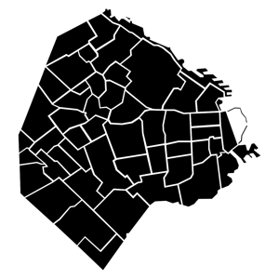
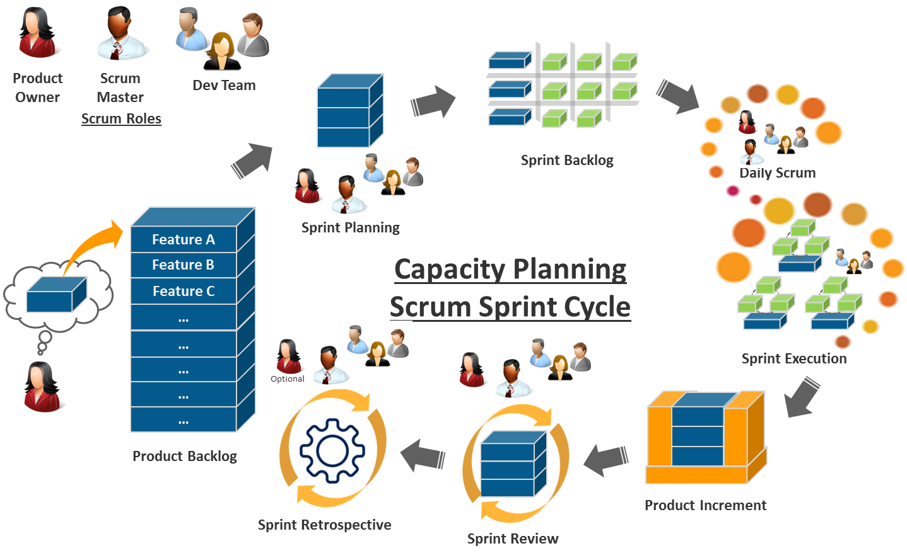
Our Solution
Devon values and use of Agile Methodology
Devon Values
Hire the best people
Always do the right thing
Deliver results
Be a team player
Be a good neighbor
Agile Methodology
We used an agile approach to develop a minimal viable product. The reason that we used this approach is that we believe it’s critical for both the business and technology teams to collaborate with each other as this app is progressed.
Benefits Include
Prevent Screen-outs
Provide wholistic view of wells
3. Access to information incl. cost basis
4. Enhanced data visualization for PICs

Slide 5
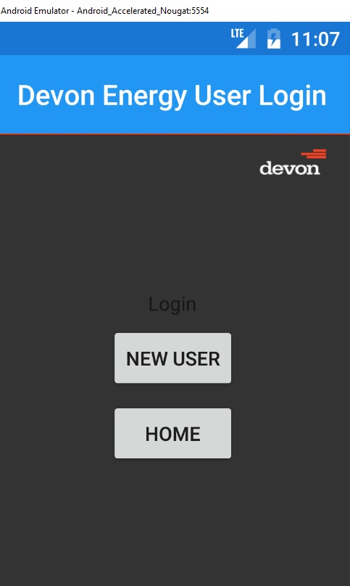

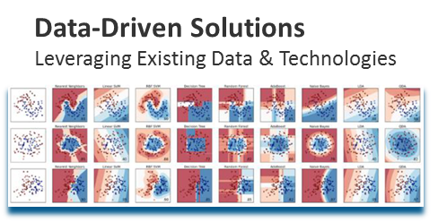
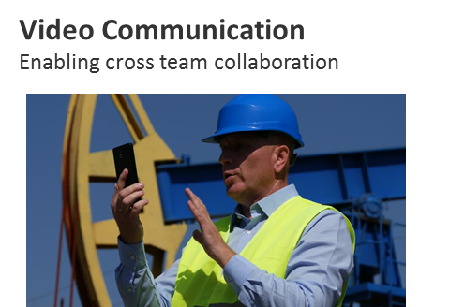
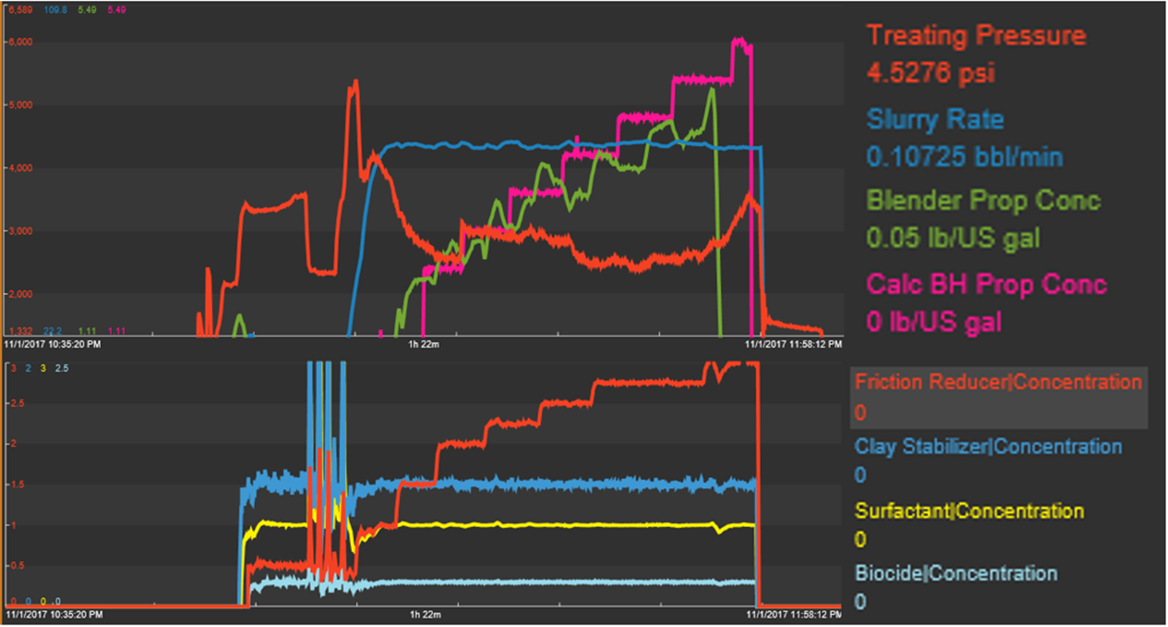
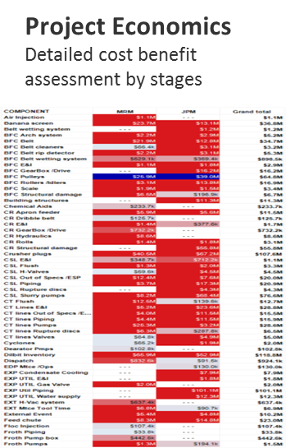
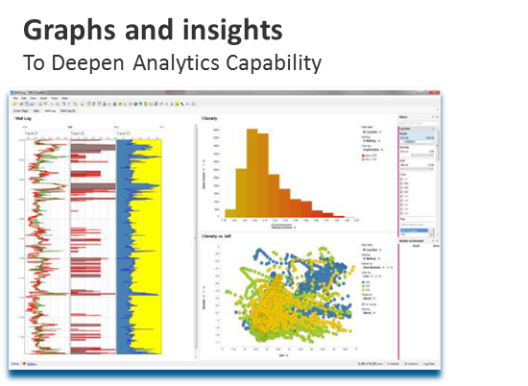
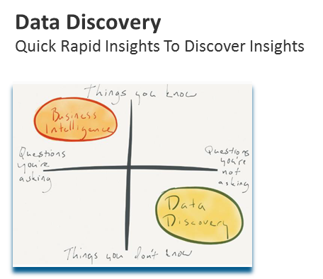
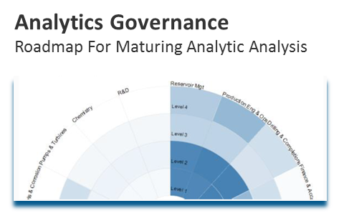
Devon’s Completion Application
Wireframe and visualization
Our app focuses on two personas - (1) the person in charge and (2) and also those in the business who are responsible for project economics that would include the wells that are being completed within the same field and the wells already producing in the field.
Screen 1
Screen 2
Visualization examples
PIC ID: 77888777
Site #: 25
Location: YYZ
Frac. Data Summary
Alerts
Historical Data
By Stage
Support & Help
Game
Start Video Chat

Slide 6
Mobile Application Attributes
Completions
Analytics
Key Characteristics
Descriptive
Adaptive – Learn as information changes and tolerate ambiguity; feed on dynamic data in near real-time
Interactive – Interact with users in near real-time. Interact with other processes, devices, and applications (cloud or premise)
Iterative/Stateful – Remember previous interactions in a process and return information that is suitable for that application at a point in time
Contextual – Understand meaning, context, syntax, time, location, regulations, and process task
Diagnostics
Predictive
Prescriptive
Machine Learning
Natural Language Processing
Knowledge Representation
Artificial Intelligence

Slide 7



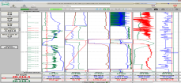
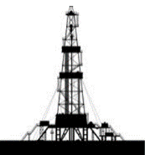

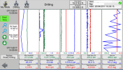
Conceptual Architecture Diagram
Local Desktop Visualization
Real Time Center Desktop Visualization
Well Master Data
Real Time Data Feed
Real Time Center Mobile Visualization
Completions Service Provider
Field Data Aggregator
Data Aggregator Server
Local
Analytics Engine
Central Analytics Engine
Completions Engineer Desktop Visualization
Local Mobile Visualization
Aggregates data from from multiple wells
Survey Data
Completions Engineer Mobile Visualization
Legend
Internal
Third Party

Slide 8
Machine Learning Tools
Data Robot, Falkonry

Slide 9



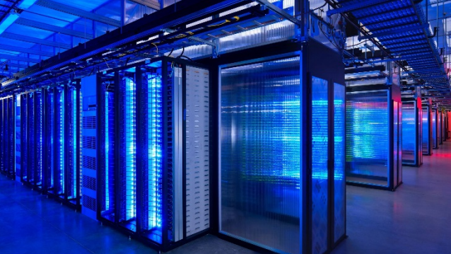
Re-imagine future….
Evolution
Experience
Culture

Slide 10
Appendix

Slide 11
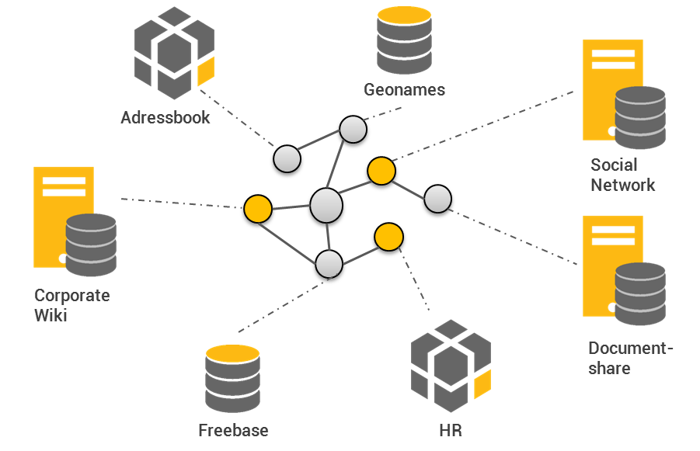
Sources Of Knowledge Representation
Transitioning From Human To Machine Knowledge
Source: The Master Algorithm – Pedro Domingos
AND NOW…Machines
Most Of The Knowledge In The World In The Future Is Going To Be Extracted By Machines And Will Reside In Machines…
---Yann Lecun, Director Of AI Research, Facebook
Evolution
Experience
The Knowledge Graph is a knowledge base made popular by Google to enhance its search engine's search results with semantic-search information gathered from a wide variety of sources.
Culture

Slide 12
Enaxis Agile IT Portfolio Management Methodology
Our primary focus will be on the Planning & Governance Components
Execution & Tracking
Planning & Governance
Business Strategy
IT Strategic Alignment
A
IT Strategic Alignment
Business and IT priority alignment
Enterprise Communications
External Benchmarking
Benefits Realization
Optimize IT
Portfolio
For Business
Value
B
Demand Planning
Capture and assess needs
Demand forecast & prioritization
Capabilities & resource management
Demand
Planning
Program Management
C
Investment Management
Business case development w/ ROI
Risk assessment
Cost/benefit based decisions
Investment Management

Slide 13
Planning and Governance Framework
The foundational building blocks of IT Portfolio Management
A
IT Strategic Alignment
B
Demand Planning
C
Investment Management
Key Areas
  Define Business-Technology Vision
  Track Operational Needs / Capabilities
  Develop Strategic Portfolio Roadmap
  Analyze existing portfolio and capabilities
  Prioritize demand vs. resource capacity
  Develop plan to meet demand
  Estimate portfolio TCO and risk
  Develop business cases with ROI targets
  Develop budget & investment plan
  Monitor and communicate results
Key Inputs
  Market drivers
  Corporate strategy
  Technology trends
  External benchmark
  Operational needs
  Legal & regulatory
  Internal capabilities
  Tech. partnerships
  IT capital budgeting guidelines
  Risk / ROI thresholds

